Slide 1
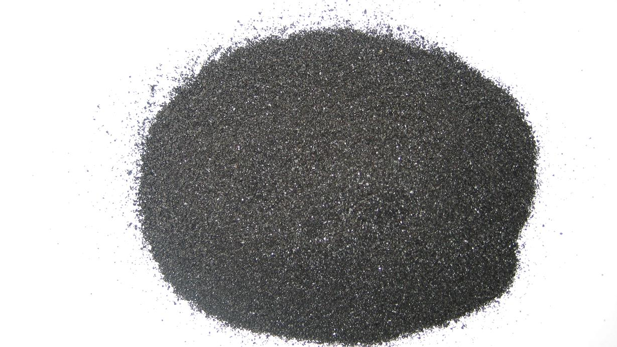

Slide 2
You will now simulate both
Exercise 5.2 on powders
Exercise 5.3 on single crystals

Slide 3
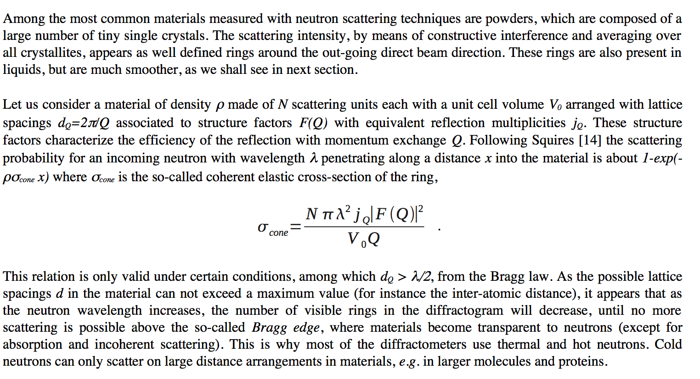
5.2 PowderN - intro

Slide 4
5.2 PowderN - construct a simple instrument file
Construct the below instrument file using mcgui….
/************************************************************************************************
* Instrument: powder_simple.instr
* %Description
* A powder scattering example.
* * %Parameters * lambda: [Angs] incoming neutron wavelength (monochromatic) * material: [Angs] Powder structure file (lazy/fullprof/crystallographica) ************************************************************************************************/
DEFINE INSTRUMENT powder_simple (Lambda=2.36, string material="Na2Ca3Al2F14.laz") TRACE
COMPONENT Source= Source_simple(dist=1, radius=0.01, focus_xw=0.01, focus_yh=0.01, lambda0=Lambda, dlambda=Lambda*0.01)
AT (0,0,0) ABSOLUTE
COMPONENT powder= PowderN(reflections = material, radius = 0.005, yheight = 0.05)
AT (0,0,0.5) RELATIVE PREVIOUS
COMPONENT banana= Monitor_nD(xwidth=1, yheight=0.3, options="banana ; theta limits=[10,130] bins=240 ; y bins=50”)
AT (0,0,0) RELATIVE PREVIOUS
END

Slide 5
5.2 - PowderN and datafiles
The equations from Squires relating to powders have been directly implemented in the PowderN component.
This handles single, coherent scattering and many d-spacing structure factors, with absorption correction and incoherent
elastic scattering. However, no multiple or inelastic scattering is taken into account,
which the Isotropic_Sqw component can cope with, in its powder mode (see exercise 9.4).
In the example at hand, we present a usage example which produces so-called Debye-Scherrer rings from a structure factor list.
The model geometry is shown in the left figure on next page, and the 2D ideal diffraction detector in the right figure on next page,
for a Na₂Ca₃Al₂F₁₄ reference powder. The choice of the material may be any file adapted from Lazy/Pulverix implemented in the
ICSD database and Fullprof (extension .laz) or Crystallographica (extension .lau also used for crystals). Currently, McStas includes
a material data base of about 70 powder and crystal definitions commonly used in neutron scattering. These can be listed from the
McGUI/Help/Component Library Index menu item, and you may easily add your own materials. The material volume may be a box,
a sphere and a cylinder, which all can be bulk or hollow geometries, including concentric arrangements, which we will hear about in
exercise 11.

Slide 6
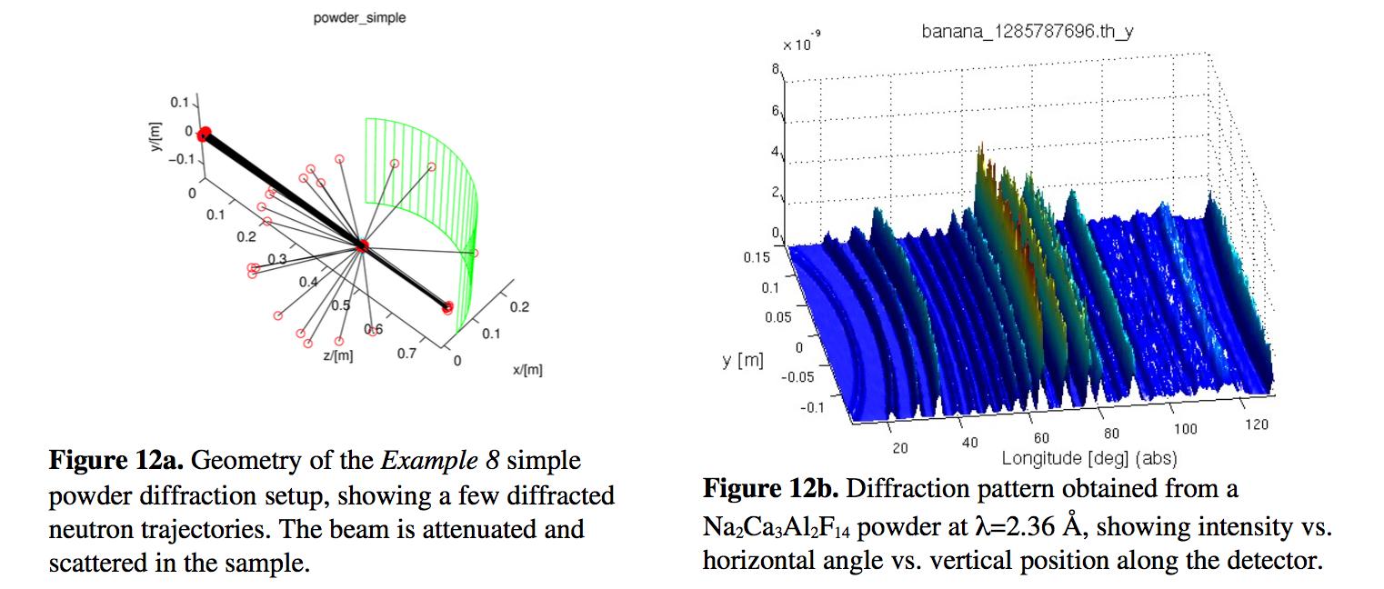
5.2 Perform simulations
Please run your newly created instrument file in trace mode and simulation mode
to see output like the ones below.
Investigate how the peak positions change with varied wavelength, try +/1 Å in
wavelength.
Also try choosing another material from your MCSTAS/data directory.
As a final optional PowderN exercise, try studying the effect of sample size

Slide 7
5.3 Single_crystal - intro
When the sample is a single crystal, the averaging on many crystallites that is responsible for the scattering rings in a powder does not apply.
The Bragg law is still valid, but similarly as a mirror, each atomic plane selects a single reflected monochromatic ray. As there are many structural planes available, a polychromatic neutron beam will be scattered as a large number of distinct rays, forming spots on detectors.
This happens in the monochromators as discussed during the session on optics, but in this case only one reflection of interest is used, the others are scattered around, generating background.

Slide 8
5.3 Single_crystal - construct a simple instrument file
Construct the below instrument file using mcgui….
/************************************************************************************************
* Instrument: single_crystal.instr * %Description * A single crystal scattering example.
* * %Parameters * lambda: [Angs] neutron wavelength selected by the monochromator ************************************************************************************************/
DEFINE INSTRUMENT single_crystal (Lambda=1, string material="C_graphite.lau")
TRACE COMPONENT Source= Source_simple(dist=1, radius=0.01, focus_xw=0.01, focus_yh=0.01, lambda0=Lambda dlambda=0.2*Lambda),
AT (0,0,0) ABSOLUTE
COMPONENT SX = Single_crystal(
xwidth = 0.002, yheight = 0.1, zdepth = 0.1, mosaic = 30, reflections = material, barns=0, ax=0, ay=2.14,az=­1.24, bx=0, by=0, bz= 2.47, cx=6.71,cy=0, cz= 0, absorption = 0.014, incoherent = 0.004)
AT (0,0,0.5) RELATIVE PREVIOUS
ROTATED (0,45,0) RELATIVE PREVIOUS
COMPONENT banana= Monitor_nD(xwidth=1, yheight=1, options="banana ; theta limits=[10,130] bins=240 ; y bins=100")
AT (0,0,0.5) RELATIVE Source
END

Slide 9
5.3 Single_crystal input parameters
The Single_crystal component is used the same way as the PowderN, but only accepts .lau type files from e.g. Crystallographica.
This component models coherent and incoherent elastic scattering, with multiple scattering and secondary absorption.
The material volume may be a box, a sphere and a cylinder, which all can be bulk or hollow geometries, including concentric arrangements.
The instrument geometry resembles the previous one for PowderN, now with a tilted graphite plate at the sample. As expected, the scattering shows a number of spots, which each select a single wavelength. The central spot is the direct, transmitted beam.
Currently, McStas does not provide simple ways to add inelastic scattering on top of a mono-crystalline structure, even though there is a way to simulate the neutron scattering on a a simple phonon dispersion.

Slide 10
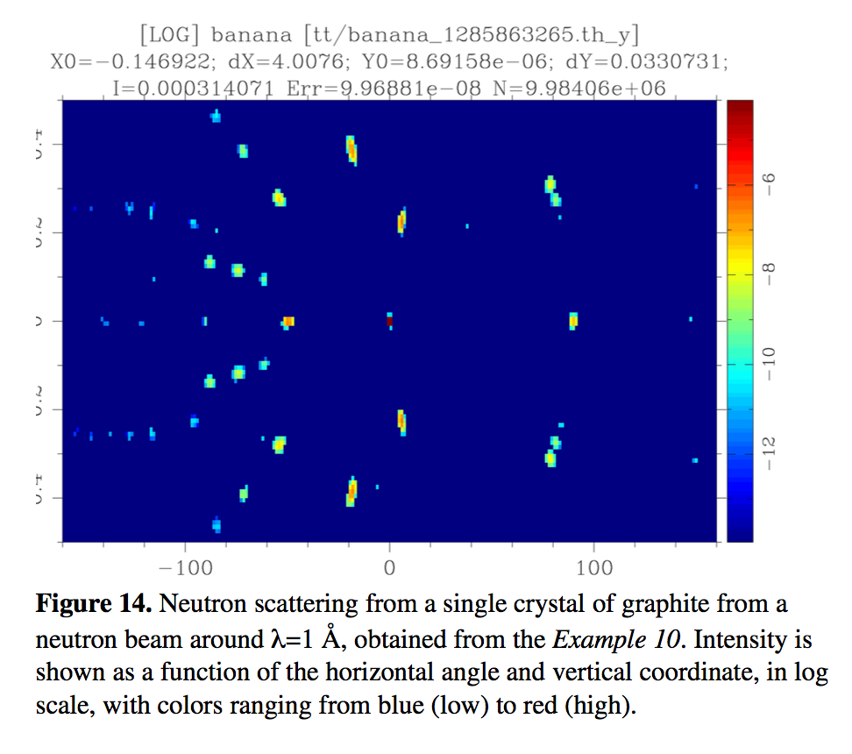
Perform simulations
Now perform trace to see that all looks OK, then a simulation that should give you output like this:

Slide 12
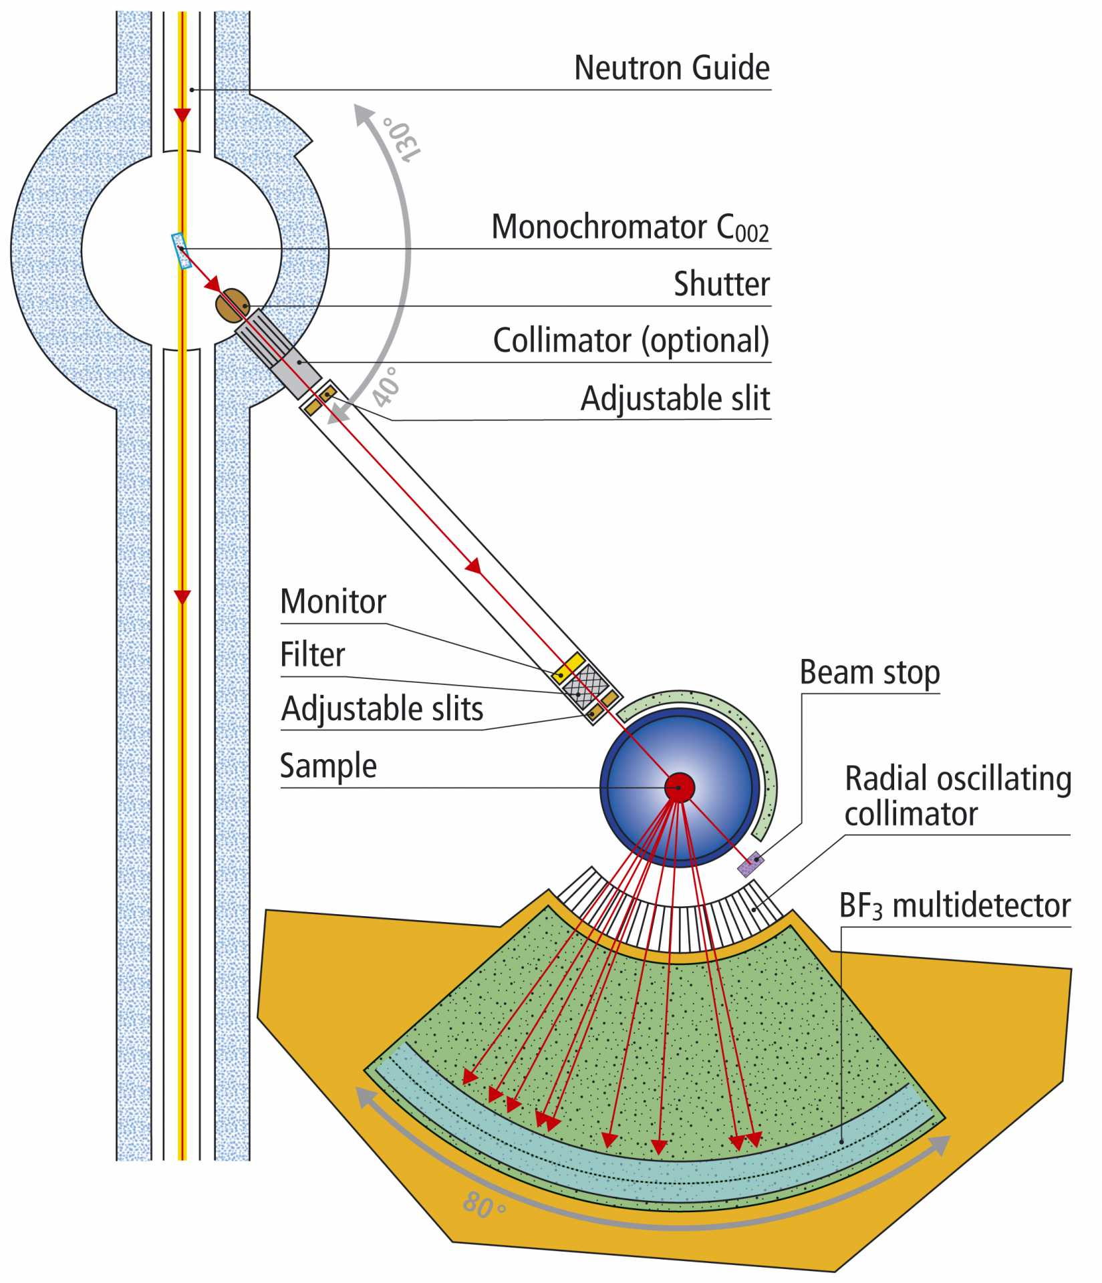
Real Instruments
PSI DMC
File → New from Template → PSI_DMC
Run the instrument with it’s default parameters.
Now we’ll try to insert a Single crystal instead of the default Powder.

Slide 13
Real Instruments
PSI DMC
Increase the height of the detector and make it resolve the signal along y.
Set:
Options="banana, theta y auto limits bins=20", yheight=0.3
In the detector.
...and change the sample to be e.g. an Aluminium crystal.
COMPONENT single_crystal = Single_crystal(
reflections="Al.lau",
yheight=0.05, radius=0.01, mosaic=1, delta_d_d=1e-4,
az=4.0495, ay=0, ax=0, bx=4.0495, by=0, bz=0,
cx=0, cy=4.0495, cz=0,
p_transmit=0.1)
AT (0, 0, 0) RELATIVE PREVIOUS

Slide 14
TOPAZ and SENJU
Take a look at a couple of “real” instrument simulations of Laue Cameras: they both resides in the Dropbox under “McStas_Diffraction, Laue”
1. SNS TOPAZ
2. J.PARC SENJU (aka. BL18)
Here you need to also copy a datafile for the J-PARC source “source_BL18.txt”
Surgeon General’s Warning: There are lots of COMPONENTS here

Slide 15
Optional extras
Create an instrument input parameter omega to allow rotating the sample.
Perform a scan and look in the subfolders how the spots move on the detector.
Also try
Decreasing and increasing the wavelength spread
Comment on the results

Slide 16
Optional extras
An additional complex geometry enables to use any point set to describe the material volume (geomview OFF file).
Try the same simulations with an OFF file from the MCSTAS/data directory

